Slide 1

Getting started with MonoGame using Visual Studio 2017
Darkside of Monogame
Simon Jackson
Author and Microsoft MVP
@SimonDarksidej

Slide 2

News headlines
As of March 2017, we have two major events
MonoGame 3.6 was released
Visual Studio 2017 was released

Slide 3
Getting Started – Visual Studio 2017
Session will cover what is needed for:
  Developing games for Windows desktop / Linux / OpenGL
  Building Content Pipeline Projects
  Developing Game for Android
  Developing Games for iOS / MacOS
  Developing Games for Windows 10 UWP

Slide 4
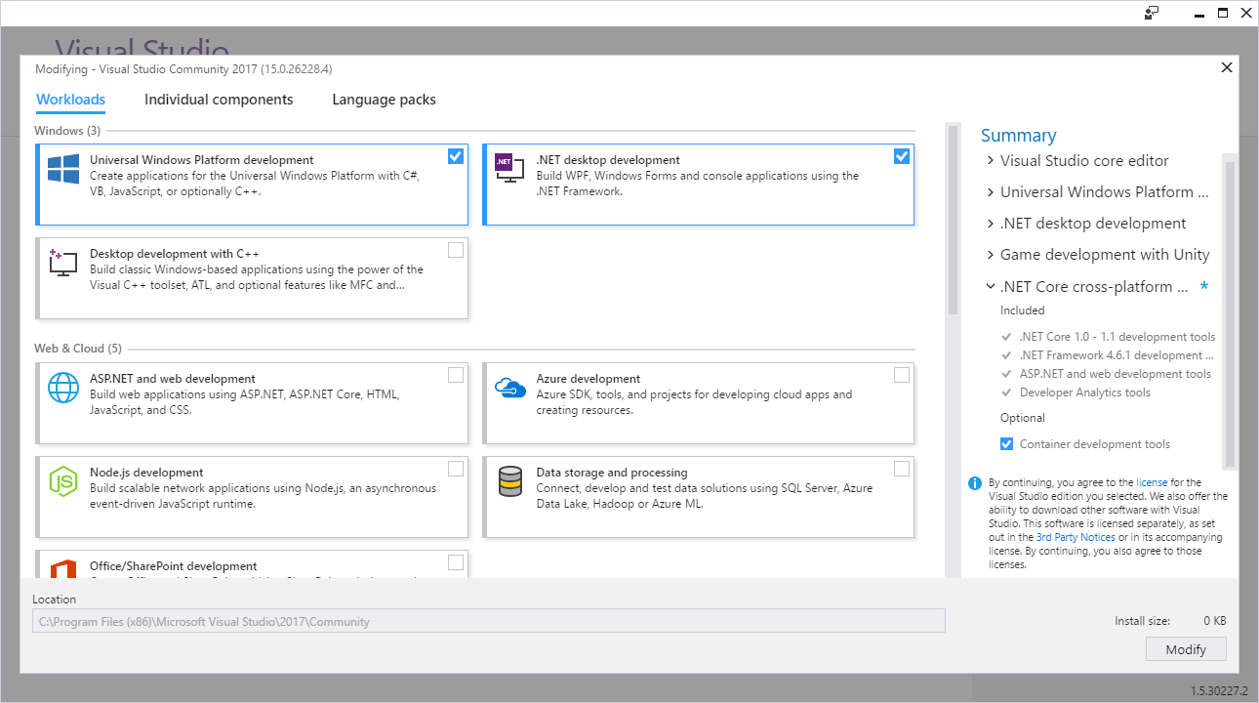
The new Visual Studio 2017 installer

Slide 5

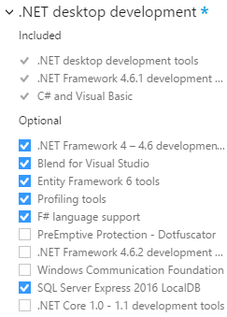
Visual Studio 2017 .NET install
Out of the box with VS 2017 (not selecting anything) you cannot do much
(Except create a blank VS solution :S)
By installing the .NET desktop module, you can build the following project types:
Windows Desktop DX (classic)
Cross-Platform OpenGL (Linux / Windows / Etc)
Content Pipeline Extensions
!!All other templates will not work or error
without additional VS2017 options!!
Gets you a basic game up and running or several platforms
Be sure to check the video below for best-practices in setting up a
multi-platform MonoGame Project:
http://bit.ly/monogamemulti-platform

Slide 6
Building for Android
What’s required for android development

Slide 7
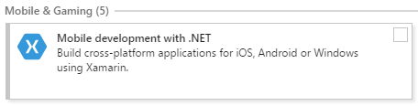
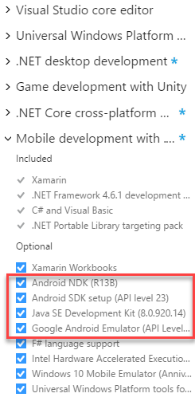
Android setup for Visual Studio 2017
Requires the Mobile development with .NET module
(C#/.NET Xamarin)
Requires Android NDK (native dev kit) for target builds
Requires Android SDK for target builds
Optional – Google Android emulator
Optional – Java SE SDK
Optional – Xamarin account (recommended)
For additional SDK’s and the Visual Studio Android Emulator,
also install the “Mobile Development with C++” module

Slide 8
Tips ‘n’ tricks with Android
Be aware it’s a fragmented platform – likely need several projects
Use MS Android emulator over Google Android Emulator
(unless you like pain)
MS Emulator requires a minimum machine with 8GB memory
Alternatively use connected device or Google Emulator
Physically testing is critical due to device differences, plan ahead
Use Xamarin cloud test or the recently announced Azure Mobile test platform (Xamarin cloud Mk2) at:
http://mobile.azure.com (currently in preview)
Get a Xamarin account, it’s free and gives you update news

Slide 9
Building for iOS / MacOS
What’s required for Apple development

Slide 10
iOS setup for Visual Studio 2017
Only requires the Mobile development with .NET module
(C#/.NET Xamarin)
Optional – Xamarin account (recommended)
Requires a MAC build host machine!

Slide 11
Tips ‘n’ tricks with iOS / MacOS
Cannot build for MAC on Windows. Can only be done on a MAC ☹
iOS builds require a MAC to build on, can develop on Windows
Physically testing is recommended, plan ahead
Use Xamarin cloud test or the recently announced Azure Mobile test platform (Xamarin cloud Mk2) at:
http://mobile.azure.com (currently in preview)
Get a Xamarin account, it’s free and gives you update news

Slide 12
Sorting out your Mac Build Host
You need a MAC ☺ but can be done with a cheap Mac Mini if you don’t have one
(But check the following requirements before buying)
Requires:
  The latest iOS SDK.
  The latest version of Xcode.
  Mac OS X Yosemite(10.10) & above.
  Apple Dev Center account
Xamarin Software is FREE now, even on Mac
Extended capabilities will require either a Xamarin License or MSDN subscription
See the following site for more details
https://developer.xamarin.com/guides/ios/getting_started/installation/mac/

Slide 13
Building for Windows 10 UWP
What’s required for Windows 10 development
Windows / Mobile / Xbox / IOT / Hololens

Slide 14

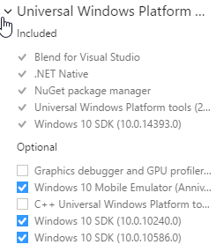
Windows 10 Visual Studio 2017 profile
Requires Universal Windows App Development Tools
Needs all SDK versions, so ensure you select them in the properties panel on the right hand side of the installer
Windows 10 machine enabled for either “Sideloading” apps or “Development Mode”
Settings -> Update & Security
-> For Developers
Optional – Windows Mobile 10 Emulator
Windows Store license required to ship (one time fee)

Slide 15
Tips ‘n’ tricks with Windows 10
“It just works” ™ :D
Keep an eye on the PR’s / Issues list. UWP received a lot of performance updates and tweaks for 3.6
Be aware there was a late reported issue with standalone Visual Studio 2017 installs
If using VS2017 on it’s own, use the development release install below until the point release is deployed
MonoGame for Visual Studio dev - http://bit.ly/monogamevsdevsetup
As UWP is a “one size fits all” platform, plan for resolution / input patterns that your game will use. Remembering some platforms don’t have touch (I’m looking at you Xbox!)

Slide 16
Tips ‘n’ tricks with Windows 10 (cont)
MonoGame fully supports the new “Creators Dev program” as well as ID@Xbox
If you want to take your UWP game to native Xbox, talk to the MonoGame team for access to the Xbox branch
(requires ID@Xbox agreement)

Slide 17
Other considerations

Slide 18
Other considerations building with MonoGame
Plan your content
If targeting multiple platforms, try to use a single shared content project to reduce overhead
Add additional “platform specific” content projects only when required
Market early
It’s essential to build up good relations with each market store. Almost never too early to “get out in front”
Test often
Some platforms will require more testing than others, plan to test deployment and not just gameplay. Use test tools where possibe.

Slide 19
Thanks for watching
Darkside of Monogame
Simon Jackson
Author and Microsoft MVP
@SimonDarksidej

